Slide 1
Energy Management Systems Business Case for EnMS
This presentation gives an overview of the EnMS and summaries benefits and barriers

Slide 2
Source: IEA 2015
Notes:
The slide shows the need to reduce CO2 emissions from energy consumption in absolute terms.
It also shows the very significant part the energy efficiency can play in industry.

Slide 3
Summary of Achievements (9 countries of UNIDO-GEF Program)
303 UNIDO Qualified EnMS Experts
271 Enterprises with EnMS implemented
5,183 energy efficiency practitioners and enterprise personnel received training in EnMS
Average annual energy savings of 7,149 GWh
Annual CO2 emission reductions of 4,302 ktCO2
Annual savings of $82,000,000 without considering non-energy benefits
Notes:
Additionally:
Energy prices very low, savings over $400,000,000 at European prices
Qualified experts are implementing many more projects in each country independently of the data collected here.
NEBs could be more than double this.
Thus total likely greater than $1B at EU/US prices.
Additional external benefit is reduced need for supply of this much energy, e.g. over 800MW of electrical power generation avoided.

Slide 4
Change in technology
Change in driving factors
EE project
Production
Product mix
New production line
New building
Weather
Occupancy
Change in energy
consumption
React
Culture
Monitor
Leadership
Develop models
Operational control
Use of data
Change in behaviour
Notes:
This slide shows that technology, people and use of data can affect energy consumption in an organisation.
All 3 are part of an effective EnMS.

Slide 5
EnMS - ISO 50001 simplified
Commit to
change
kWh
Check the results
Plan the changes
($ + CO₂)
Make the
changes
Notes:
The central purpose of ISO 50001 is to help organisations to reduce energy use (kWh or GJ). This will result in reduced energy cost and reduced CO2 emissions.
The cycle is to build support and commitment for change and improvement from the top management. Usually the most difficult part.
The next step is to decide what to do to improve performance, i.e. develop plans
Then the savings are actually achieved when we make the changes
Finally we need to check the results to ensure that we are actually making the savings.
This is a continuous cycle with continuous improvement of all aspects including building management support and leadership.

Slide 6
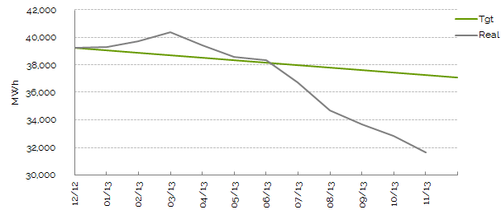
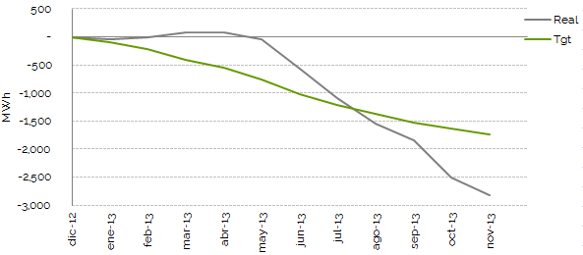
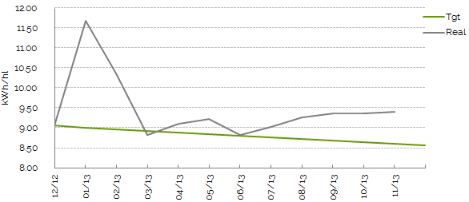
Different purposes and views
MWh per year
-17%
Actual MWh
-9%
kWh/hl
+2%
Brewing industry
Notes:
Discuss absolute down 16.74%, SEC up 2.19%, multivariate regression down 8.94%. In this period energy consumption reduced and also production reduced. Thus we need to consider carefully how to understand performance. In this case the energy manager had been informed that he was not performing very well as the company used SEC (+2.19%) as their EnPI, while in fact his performance had improved by 8.94%. It is very demotivating to be told you are doing a bad job if in fact you are improving.
Same data and same actual results

Slide 7
Energy per unit of production
Car assembly industry
Notes:
The energy manager in this plant stated that they had improved by 5% over these 3 years from 2008 to 2011, based on 100 energy units per vehicle to 95.
What happened in 2009? Global financial crisis in 2008 caused production of cars to reduce in 2009. Thus we say that when this indicator improves we are doing a good job and when it increases it is because of reduced output.

Slide 8
"How many managers have been told by their staff that bad coal consumption was due to low output? How is it possible for them to judge whether this is an excuse or a reason?”
These are the opening words from a fuel efficiency bulletin, published in 1943 by the Ministry of Fuel and Power, which criticises the "ton of coal per ton of output" metric as a misleading indicator of fuel efficiency.
The author was Oliver Lyle, managing director of the eponymous sugar refinery, a very knowledgeable and eminent engineer who had no time whatever for the Specific Energy Ratio. Any works engineer today will know that SERs vary continuously for reasons nothing to do with energy efficiency.

Slide 9
Benefits to the organisation
Reduced:
operating costs
environmental impact
exposure to volatile energy prices
exposure to carbon taxes
Improved:
corporate social responsibility and image
control of operations
knowledge of energy efficiency
reliability and productivity
interdepartmental cooperation

Slide 10
Typical Barriers
People
Lack of commitment and support from decision makers
Lack of interdepartmental cooperation
Technology
Technical knowledge of energy aspects of operations
Realisation that savings can be made with no investment
Data
Reliance on inaccurate and misleading indicators (e.g. Specific energy consumption)

Slide 11
What should you do next?
Start to build support among the decision makers
Carry out the gap analysis to identify areas to improve.
Analyse the current energy efficiency of the organisation.
Identify the specific benefits to your organisation
Identify the likely barriers you will encounter
Plan how to address these barriers.
Notes:
Capacity building at policy and plant levels and all levels in between.

Slide 12
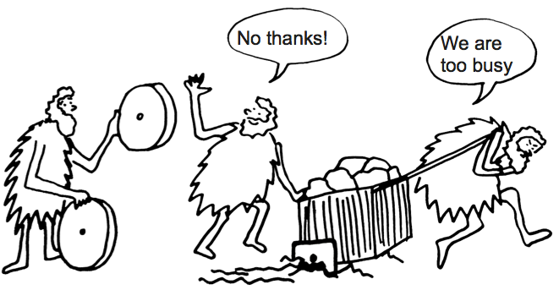
Is it easy to improve?

